Slide 1
Final Year Engineering Report Writing Process

Slide 2
Objectives
Answer your questions about 4th year reports.
Look through a sample report to give a sense of the scope of each section and what needs to be included.
Discuss some tips for researching efficiently and keeping track of your ideas.
Review rules of formal writing style.
Talk through proofreading for common errors (optional).

Slide 3
What your report should do
Your report should provide a factual and accurate account your design or research project. Your main goal is to logically communicate:
What problem you investigated and how. (And why—based on past research/sources.)
What you designed or found.
What your results mean. (Including possible uses of this information.)

Slide 4
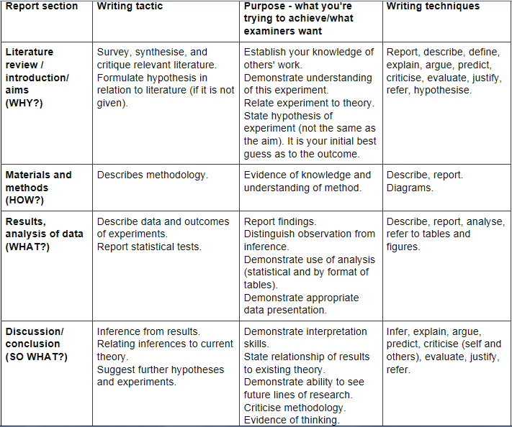
(Murison & Webb, 1991)

Slide 5
Structuring your report
Start with an outline or map
This is your draft TOC
At the end of your writing process, you will check back with this and make sure sections match
Structure it sensibly, deciding what to include and what goes in appendices
Limit the scope explicitly
Tell a logical story
Refer back to beginning goals in the final section

Slide 6
Abstract
State main objectives. (What did you investigate? Why?)
Describe methods. (What did you do?)
Summarise the most important results. (What did you find out?)
State major conclusions and significance. (What do your results mean? So what?)
(University of Wisconsin-Madison, 2012)

Slide 7
Introduction
An introduction should:
Outline the background theory relevant to your experiment.
Review the current literature in order to justify your hypothesis.
Explain the relevance of the experiment.
State your aim.
State your hypothesis.

Slide 8
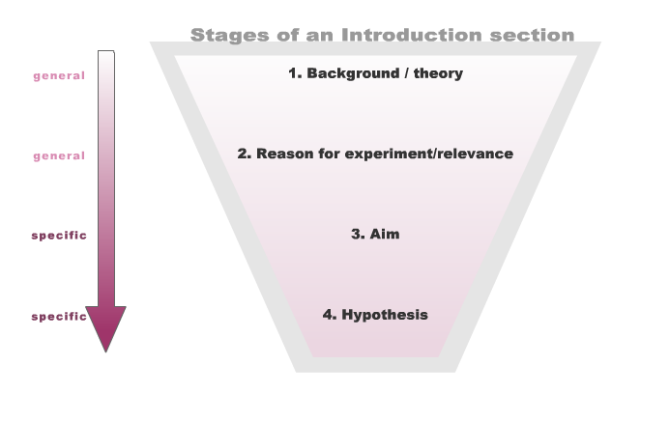
Introduction
(University of Sydney, 2012)

Slide 9
Methods
Outline exactly what equipment, subjects and materials were used.
Explain how the equipment was set up and utilised.
Describe the procedure that was followed.
Ensure that the experiment could be replicated using the information you present.

Slide 10
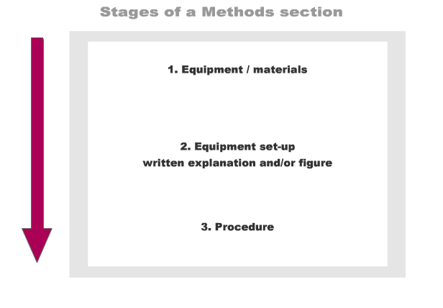
Methods
(University of Sydney, 2012)

Slide 11
Results
The raw data that is produced during your experiment.
It is most common to present this data in tables and/or graphs (sometimes appendices are also used to present more detailed information).
Make summary comments about your results. Highlight the data that displays the most meaningful connection to your hypothesis (but do not discuss).
Think forward to your discussion section.
(Australian National University, 2010)

Slide 12
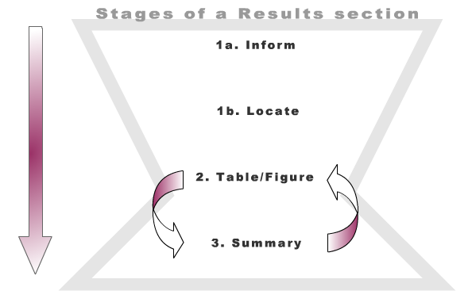
Results
(University of Sydney, 2012)

Slide 13
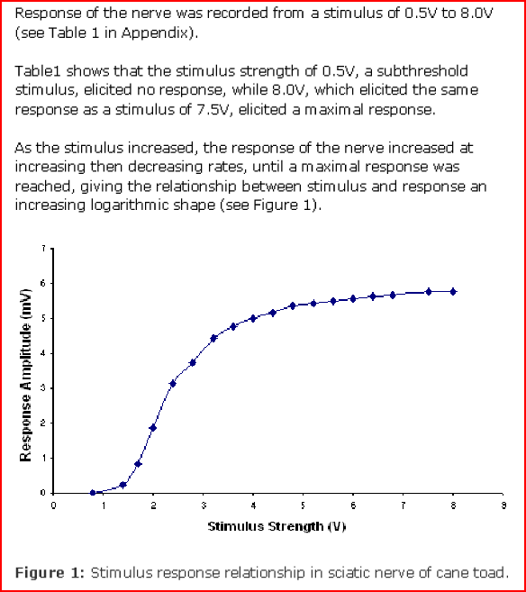
(University of Sydney, 2012)

Slide 14
Discussion
Not simply a restatement of the results but interpretation of the data. What do the results mean?
Data should be related to existing theory and knowledge.
Explain the logic that allows you to accept or reject your original hypothesis / hypotheses.
Suggestions for the improvement of techniques or experimental design can be made.
Elaborate on future experiments that might clarify areas of doubt in your results.
(Dolphin, 1997; UNSW, 2012)

Slide 15
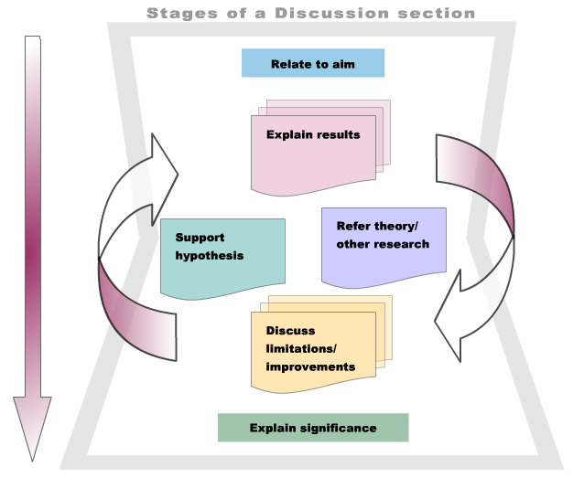
Discussion
(University of Sydney, 2012)

Slide 16
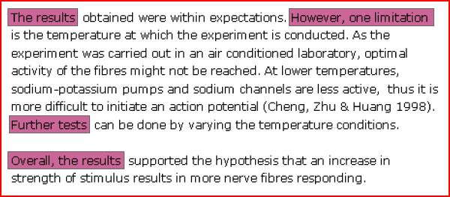
Example discussion (extract)
(University of Sydney, 2012)

Slide 17
Conclusion
Briefly highlights main contribution of project.
Sums up the discussion section, and restates the significance of the main findings of the experiment.
Restates recommendations if relevant.
Links back to the theoretical model and the introduction.

Slide 18
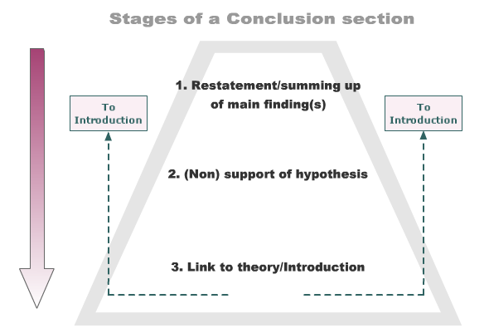
Conclusion
(University of Sydney, 2012)

Slide 19
The research & writing process
Keep a separate list of research questions and prioritise them according to most and least essential.
Keep a master document of search terms and key topic vocabulary. (Consider using MindMeister, ECU’s mindmapping tool).
http://intranet.ecu.edu.au/__data/assets/pdf_file/0004/204961/Mindmeister_Information.pdf
http://intranet.ecu.edu.au/__data/assets/pdf_file/0016/323053/Mindmeister-instructions-Portrait.pdf
Use “subject terms” in library database.
Start with subject guides
http://ecu.au.libguides.com/profile.php?uid=30816
Need a demo?
Check in with your adviser often with questions.
Meet/email with a subject librarian for assistance with finding appropriate sources (Karen Lycett, k.lycett@ecu.edu.au)
Stay on top of where you are with a master project mgmt plan.
Use outlines for each section and sub-section.

Slide 20
The research & writing process cont’d
For the background, start with recent articles that give overviews of the state of current research about your design.
Get a sense of the “story” of what we know so far about your research/design area.
Remember that this is not a 1000 page book! You need to make efficient choices about which info to include. Focus your research attention wisely (and ask for help if you aren’t sure).
If it doesn’t make sense to you, that will be obvious in what you write.

Slide 21
Reverse outlining
Do this one section at a time when you are feeling fresh and alert.
Underline the controlling idea in each paragraph.
Add in a topic sentence if one is missing announcing that idea.
Move extra ideas to a separate paragraph.
(Seek further research where needed.)
Go through the section and add structuring language. (eg There are three competing models… The first model for ____ is… The second model is…)
Make sure the intro begins and the concl ends, and that movement is from general to specific and then out again.
Link back to promises made in your report intro/roadmap.

Slide 22
Report language
Although your markers may be experts in this topic area, you must make your thought processes explicit.
Be concise and precise.
Use references when appropriate—provide a context for your contribution to what we know in this field.
Both markers must be able to see that you understand the research context, make critical observations and reflect on the implications of the project.

Slide 23
Top priority #1: Clear meaning
In the event of life-threatening conflagration, expeditiously transport your person through the indicated egress of closest proximity to your location.
In case of fire, quickly leave through the nearest door marked “EXIT.”
This means your writing will be stronger if you avoid the impulse to make it sound professional/academic.
If you struggle to write clearly in general, short sentences are your friend!
(Shelton, 1994, p. 21)
Notes:
In case of fire, quickly leave throuth

Slide 24
Features of academic writing (1)
Formality – avoid contractions, colloquialisms , clichés, and redundancy.
Cliches include phrases like:
At this point in time (instead write “at this time”)
During the course of (instead write “during”)
On a weekly basis (instead write “weekly”)
Redundant phrases include:
Square in shape
Precision – avoid vagueness when citing figures and dates. Use key words consistently (and repeat them). Quantify when possible.
Objectivity – maintain a critical distance from your work. Your evaluation is important as informed analysis of research, but should be evidence-based whenever possible.

Slide 25
Features of academic writing (2)
Explicitness – explain to the reader exactly what you are going to do and when you are going to do it.
Signpost your work and use signal words properly so your reader can follow your train of thought (e.g. ‘however’, ‘because’, ‘similarly’, ‘in addition’).
Incorporate figures by referring to diagrams, graphs, etc explicitly in your text. Clearly state why the reader should look at the figure. (“Note that the diagram below shows this process in detail…”)
Accuracy – cite facts and figures correctly. Use vocabulary accurately.

Slide 26
Features of academic writing (3)
Hedging – be assertive in elaborating your stance on the topic, but use cautious language. Use phrases like: ‘These results suggest...’, ‘It could be the case that...’, ‘It is useful to study...’
Responsibility – your work forms part of a scholarly ‘conversation’, so take responsibility for it. Provide evidence for all claims. Directly dialogue with the writers of your sources (esp. in background).
(Gillett, 2012)

Slide 27
Nominalisation
“The Americans beat the Russians by landing on the moon first.”
“The first lunar landing was an important American victory over Russia.”
Verb
Verb
Verb | Nominalisation
evolve | evolution
produce | production
react | reaction
respond | response
discuss | discussion
Noun group
Noun group

Slide 28
Verb tense
The experiment is already finished, therefore you should use the past tense when discussing it:
"The objective of the experiment was..."
The report, the theory and equipment still exist, therefore use the present tense when discussing them:
"The purpose of this report is..."
"Bragg's Law for diffraction is ..."
"The scanning electron microscope produces micrographs ..."
(adapted from University of Toronto, n.d.)

Slide 29
Active language
Fix a confusing sentence by clarifying (or inserting) a subject & omitting “to be” verb (is, was)
(subject = the agent who does the action in the sentence)
Antiseptic content was not properly analysed by our satellite lab. (Reorder it: who did what?) | Our satellite lab improperly analysed antiseptic content.
Excessive engine wear is also characterized by low compression readings. | Low compression readings also characterize excessive engine wear.
(adapted from University of Toronto, n.d.)

Slide 30
Other tips for report writing
Avoid long sentences - (4 or more 'clauses' or parts) which might confuse the reader.
Be concise. If you can use one word instead of a phrase with two or more words, then choose the one word (‘get around’ = ‘avoid’).
Avoid emotionally loaded words (‘wonderful,’ ‘useless,’) and casual or ambiguous expressions (‘the reaction carried on for 10 minutes’).
Use technical terms correctly. Learn what they mean, how to use them and how to spell them. Include a glossary if appropriate.
(UNSW, 2012; Shelton, 1997)

Slide 31
Need some writing or research help?
Learning Adviser for postgraduate projects (including honours):
Dr Teresa Lawrence t.lawrence@ecu.edu.au 6304 2576
Learning Adviser for undergraduate projects:
Julia Wexler j.wexler@ecu.edu.au 6304 5162
Subject Librarian for Engineering:
Karen Lycett k.lycett@ecu.edu.au
Also see the library subject guides: http://ecu.au.libguides.com/profile.php?uid=30816

Slide 32
References
Australian National University. (2010). “Writing a lab report.” Retrieved from the ANU Academic Skills and Learning Centre Website: https://academicskills.anu.edu.au/resources/handouts/writing-lab-report
Dolphin, W.D. (1997). “Writing lab reports and scientific papers.” Retrieved from the McGraw-Hill Higher Education Website: http://www.mhhe.com/biosci/genbio/maderinquiry/writing.html
Gillett, A. (2012). “Features of academic writing.” Retrieved from the Using English for Academic Purposes: A Guide for Students in Higher Education Website: http://www.uefap.com/writing/feature/intro.htm
IEEE editorial style manual. (n.d.) Retrieved from http://www.ieee.org/documents/stylemanual.pdf
Monash University. (2012). “Essay or report?” Retrieved from Monash University Language and Learning Online: http://www.monash.edu.au/lls/llonline/quickrefs/06-essay-report.xml
Murison, E. & Webb, C. (1991). Writing a research paper. Sydney, Australia: University of Sydney Learning Assistance Centre.
Shelton, J. H. (1994). Handbook for technical writing. Lincolnwood, IL: NTC Publishing.
University of New South Wales (UNSW). (2012). “Writing lab reports”. Retrieved from the University of New South Wales Learning Centre Website: http://www.lc.unsw.edu.au/onlib/labrep.html
University of Sydney. (2012). WRISE Write Reports in Science and Engineering. Retrieved from University of Sydney Learning Centre Website: http://learningcentre.usyd.edu.au/wrise/
University of Toronto. (n.d.). “The lab report.” Retrieved from the University of Toronto Website: http://www.writing.utoronto.ca/advice/specific-types-of-writing/lab-report
University of Wisconsin-Madison. (2012). “The writer’s handbook: Writing scientific reports.” Retrieved from the University of Wisconsin Writing Centre Website: http://writing.wisc.edu/Handbook/ScienceReport.html
Winckel, A. & Hart, B. (2002). Report writing style guide for engineering students (4th ed.). [Adelaide]: Faculty of Engineering, University of South Australia.

